Slide 1
Bayesian Estimation of Bound Fluid Fraction from NMR Relaxation
Presented by: David Dobbie
Supervisor: Paul Teal
Co-supervisor: Robin Dykstra

Slide 2
Purpose
To improve mineral exploration:
We want to assess the viability of gas and oil wells [1]
An exploratory process
Different wells have different viability
Better where fluid is less bound to the rock
Hence, we need to find the bound fluid fraction (BFF)

Slide 3
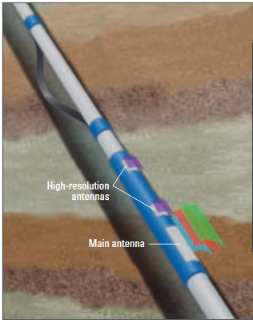
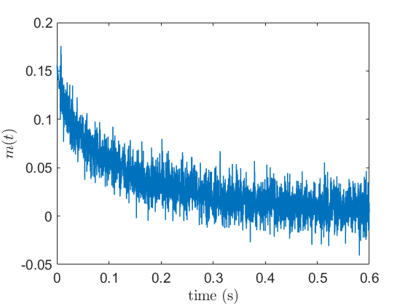
Purpose
NMR = Nuclear Magnetic Resonance
Measured with an NMR tool down a well [2]
Measurements of NMR relaxation
The downhole is very noisy
[1] Exploratory well logging tool

Slide 4
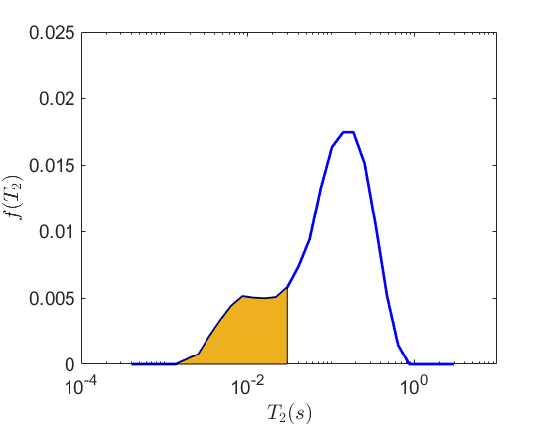
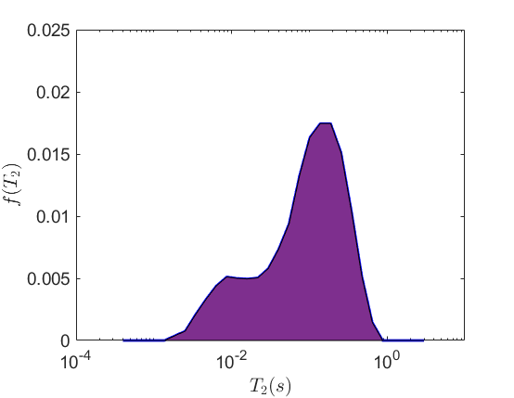
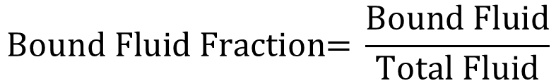
Purpose
Bound Fluid
Density of relaxation times relate to the rock [2]
Bound fluid has lower relaxation times
We can detect BFF with the density of relaxation
$$\text{Bound} \text{Fluid} \text{Fraction}\text{= }\frac{\text{Bound} \text{Fluid}}{\text{Total} \text{Fluid}}$$
Total Fluid
We need to find the density of relaxation times
However, we have poor measurement data

Slide 5
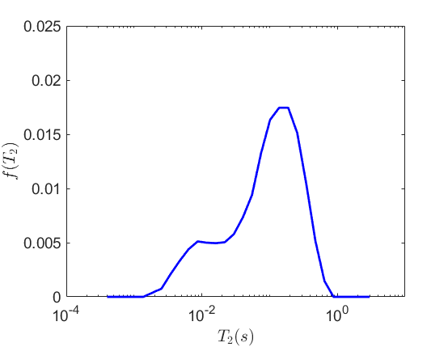
Previous Approaches
Inverse Laplace Transform (ILT)
Minimise least square error with ‘smoothing’
[3][4]
ILT+ (augmented ILT)
Adds more ways to evaluate error
Tapered area estimation
Moment estimation
Incremental improvement
[5]

Slide 6
Basis of Design
We use additional prior information
High quality experimental measurements
Use estimator for a noisy environment
cannot expect controlled lab conditions

Slide 7
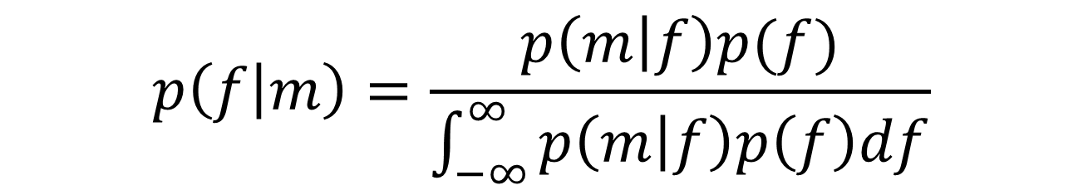
Basis of Design
We use additional prior information
High quality experimental measurements
Use estimator for a noisy environment
cannot expect controlled lab conditions
Using Bayes’ Theorem [6]
Starting Measurement
$$p\left(\left.f\right|m\right)=\frac{p\left(\left.m\right|f\right)p(f)}{\int_{−∞}^{∞}{p\left(\left.m\right|f\right)p\left(f\right)df}}$$
Prior density function
Posterior – our estimate

Slide 8
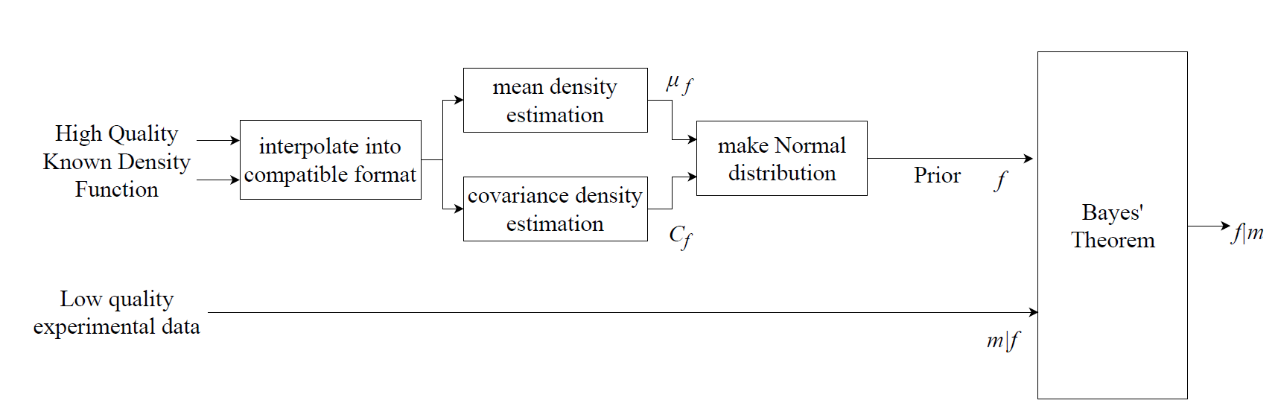
System Workflow
Laboratory Data
Testing via cross validation [7]
Penalises overfitting in evaluation

Slide 9
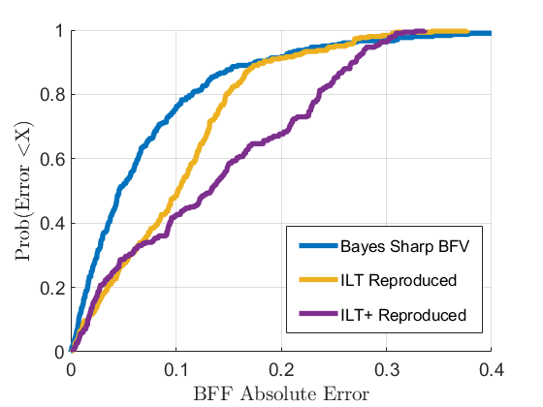
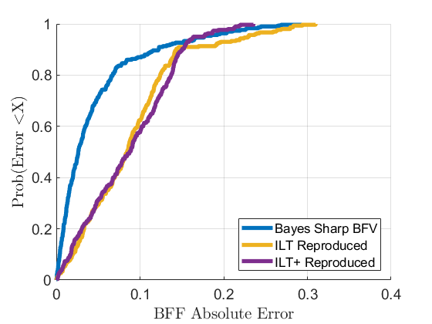
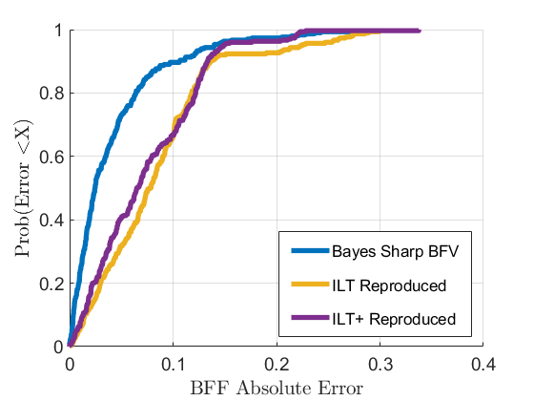
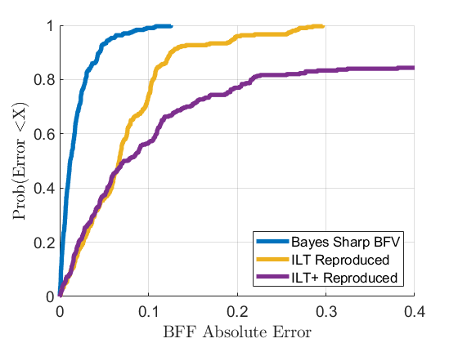
Evaluation - SNR
Better
Worse
BFF estimation absolute error
For different signal-to-noise ratios
Bayes method outperforms all other methods
SNR = 1
SNR = 5
SNR = 10
SNR = 100

Slide 10
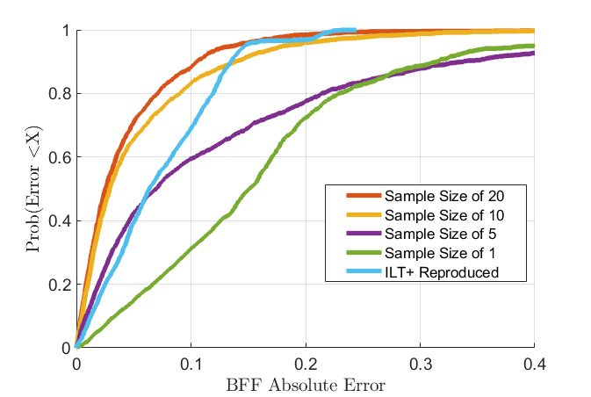
Evaluation – Prior Information
For different sample sizes for the experimental prior
Less experimental density functions means worse performance
SNR = 10

Slide 11
Conclusion
Bound fluid fraction
How well a material holds fluid?
NMR relaxation
Noisy environment detecting physical nature
Bayesian estimation
Given good data – outperforms current techniques
May extend to other low SNR cases such as
food quality evaluation
fast medical sensing

Slide 12
References
[1] R. Akkurt, H. N. Bachman, C. C. Minh, C. Flaum, J. LaVigne, R. Leveridge,R. Carmona, S. Crary, E. Decoster, N. Heaton,et al., “Nuclear magnetic resonance comes out of its shell,”Oilfield Rev, vol. 20, no. 4, pp. 4–23, 2009.
[2] M. D. Hürlimann and N. J. Heaton, “NMR Well Logging,” in Mobile NMR and MRI: Developments and Applications(S. J. V. Edited by MichaelL. Johns, Einar O. Fridjonsson and A. Haber, eds.), ch. 2, pp. 11–79, TheRoyal Society of Chemistry, 2016.
[3] L. Venkataramanan, Y.-Q. Song, and M. D. Hurlimann, “Solving Fredholm integrals of the first kind with tensor product structure in 2 and 2.5 dimensions,”IEEE Transactions on Signal Processing, vol. 50, pp. 1017–1026,May 2002.
[4] J. P. Butler, J. A. Reeds, and S. V. Dawson, “Estimating Solutions ofFirst Kind Integral Equations with Nonnegative Constraints and Optimal Smoothing,”SIAM Journal on Numerical Analysis, vol. 18, no. 3, pp. 381–397, 1981.
[5] F. K. Gruber, L. Venkataramanan, T. M. Habashy, P. M. Singer, and D. E.Freed, “A more accurate estimate of T2 distribution from direct analysis of NMR measurements,”Journal of Magnetic Resonance, vol. 228, pp. 95 –103, 2013.1
[6] C. M. Bishop, “Pattern Recognition and Machine Learning,” ch. 2, p. 93,Springer, 2006.
[7] M. W. Browne, “Cross-Validation Methods,”Journal of Mathematical Psychology, vol. 44, no. 1, pp. 108 – 132, 2000.

